Slide 1

QSyncer2
Embert
WGT2
2008/03/04

Slide 2


Agenda
Introduction
  What’s “QSyncer” ?
  Supported Protocols
  Platform Requirement
Functionality
  Major Key Features
    Contact
    SMS
    Calendar
    File manager

Slide 3

What’s QSyncer
It’s similar to “ActiveSync”
It could sync with calendar, phonebook, SMS and files from cell phone and PC and vice versa.
More customization function
  Language set
  UI framework
  It could provide different function by different project
  Customization resource files( Logo, background).

Slide 4
Supported Protocols
Qisda proprietary AT command.
SyncML
OBEX
Plug-in framework

Slide 5
Platform Requirement
Develop environment
  Microsoft visual C++ 2005 + SP1
  Microsoft platform SDK
User environment
  Microsoft XP, Vista

Slide 6
Major Key Features & DEMO
Support UNICODE
  User can show and input multi-lingual.
Support dynamitic change language
Remember user’s setting
  Last window position
  Last active view
  Language set
Easy to change skin (Theme)
  Pictures
  Position
  String
Support drag and drop
  Not including File Manager drag files to the desktop
Notes:
Start to demo by calendar view

Slide 7
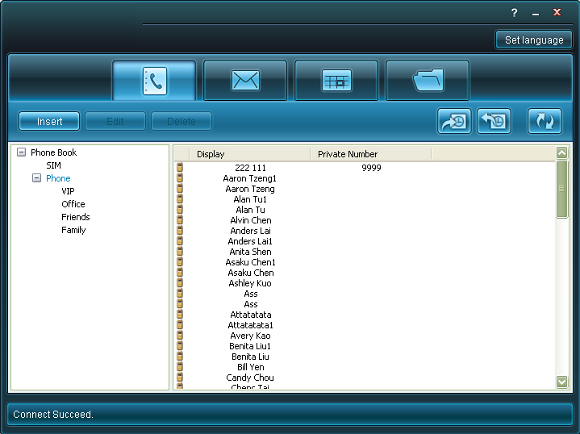
Contact
New
Edit
Delete
Sync

Slide 8
Introduction of SMS
What is SMS?
  Short message for cell phone
  Support SMS,EMS (Text only)
  Any languages (UCS2 encode)

Slide 9
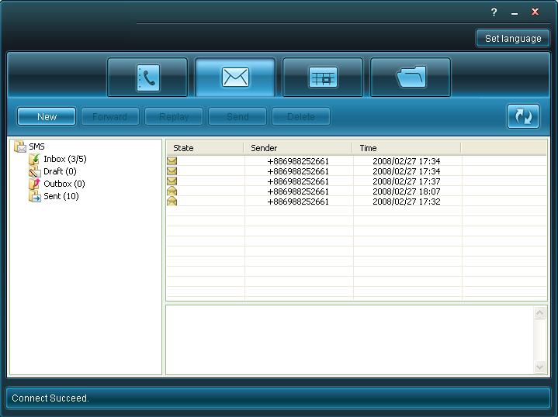
Short Message
Send
Read
Reply
Forward
Delete

Slide 10
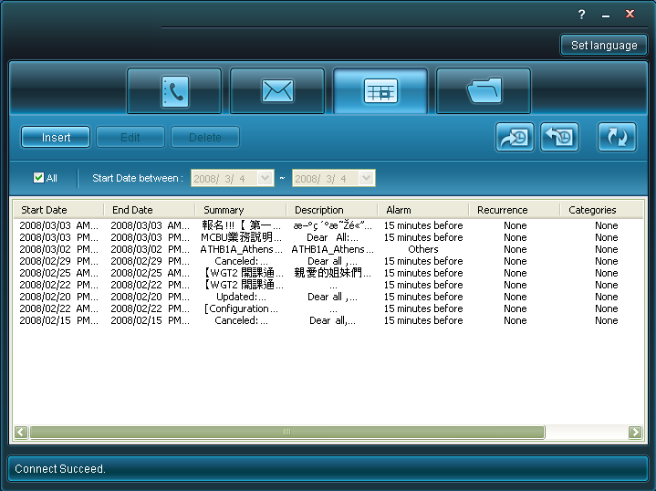
Calendar
New
Edit
Delete
Sort
Filter
  By date
Sync

Slide 11
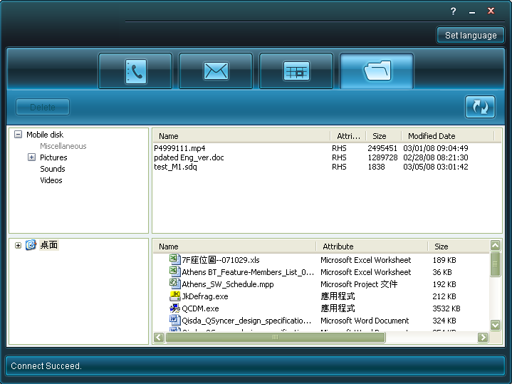
File manager
Add
Get
Delete
Rename

Slide 12

Thank you

